Slide 1
Safe Space sports club - raising awareness on the topic of child protection
Workshop for coaches, parents, assistants, board members and other adult club members
Notes:
Welcoming the participants
Optional: Have name badges put up
Describe the contents/objectives of the workshop
Improve protection against interpersonal violence in sports clubs
Gaining knowledge on the topic of interpersonal violence
Establishing a culture of looking
Getting to know how to deal with boundary violations
Target group: All adults who have contact with children and/or young people in the sports club, e.g. coaches, parents, assistants, other people who are in gyms or changing rooms at the same time.

Slide 2
((Delete if unnecessary: Personal introduction))
Name
Profession
(insert further background info if desired...)
If applicable. Contact possibility
Notes:
Introduction of the speaker by name
You can introduce yourself using the PowerPoint slide or leave it as an oral presentation (without a slide).
Delete slide if unnecessary

Slide 3

Workshop programme
Workshop content 120min
Interactive storytelling
Information on borders and children's rights
Forms and frequency of interpersonal violence in sport
Options for action for adults
Discussion of case studies in small groups
Outlook and conclusion
Notes:
Describe the course of the workshop

Slide 4
Notes for workshop participants
Sensitive topic of violence:
Compliance with general rules of dialogue, e.g. respectful atmosphere, not sharing personal experiences of others
Participants may leave the room if necessary
Opportunity for discussion after the workshop
Offers of assistance:
If participants need support after the workshop, please get in touch with the presenter, the contact person at your organisation or a specialised counselling centre
Suitable counselling services:
SafeSport point of contact:
  https://www.ansprechstelle-safe-sport.de
Nummer gegen Kummer:
  https://www.nummergegenkummer.de
Help portal for sexual abuse:
  https://www.hilfe-portal-missbrauch.de/en/home
Notes:
Notes for participants
The content of the workshop can be potentially stressful, as it deals with sensitive topics such as sexualised violence.
This workshop is intended to provide a safe space: Other people's stories should be respected and not judged, and should not be publicised.
Allow participants to leave the room or take a break.
Please offer the opportunity for a discussion after the workshop.
Point out available offers of help
If possible, also name a suitable local contact centre/contact person.
Please customise the fields marked in yellow.

Slide 5

Case storytelling
"Paper clip"
Notes:
Preparation
Before the story begins, each participant receives a paper clip.
Ask the participants to hold the paper clip in their hand.
Content/task
A story is read aloud to introduce the topic.
Explain that the paper clip plays an important role in the story and that they will use it to carry out small tasks: There will be instructions on what to do with the paper clip,
followed by a joint dissolution.
Optional: Tips for a relaxed sitting position.
Now read the story aloud.

Slide 6
Reflection on the paper clip story
Notes:
Reflection
At the end, the participants will realise that the paper clip cannot be completely bent back to its original state.
Use this moment to address the parallels with the story.
Invite participants to share their thoughts and feelings about the exercise and the story.
Possible reflection questions:
What does the clip look like now?
What thoughts does the story trigger in you
How is the situation resolved?
Optional
To make the transition to the next section easier, you can initiate a short discussion here (with the people sitting next to you or with the whole group):
How can we contribute to a safe environment in the sports club?
What are our responsibilities with regard to protection from violence?
As a result, you could add the following or use it as a transition:
Every adult in a sports club has the task of ensuring the protection and well-being of children and young people in the club in particular.
In order to better understand what this actually means, children's rights can be used as a framework.

Slide 7

Boundaries in sport
Children's rights and legal boundaries
Notes:
Sports clubs are a special environment for the prevention of sexualised violence:
Lots of work with children and young people
Physicality, e.g. assistance, one-on-ones, changing room situations
Trust between coaches and athletes
The close relationship in sport in particular can easily be exploited if there are no clear rules and boundaries
Problem: Where exactly are the boundaries and at what point is the child's welfare compromised?
The United Nations' children's rights are used as a framework, as they answer the question of how children can develop positively and with dignity.
Criminal law limits cannot serve as the sole framework for prevention and are therefore only briefly presented. (– please amend this statement according to legal regulations in your country)

Slide 8

Children's rights of the UN
... are the rights of all children and young people worldwide
... they are based on four basic principles:
  Equality and equal rights
  their welfare, protection and care
  maximum promotion of personal development
  Respect for their opinion and respect for their
  wishes in matters that affect them
Children's rights make children strong!
...that's why we deal with it in sport.
(Sportjugend Hessen & MAKISTA)
Notes:
The question of what children and young people need in order to develop positively and with dignity was posed by the United Nations Organisation in 1989, from which it developed the UN Convention on the Rights of the Child (CRC) (in 54 articles). The Convention on the Rights of the Child has been in force in Germany since 1992.
Extra rights for children and young people? Why is that?
Because children and young people have special needs in terms of their support, protection, co-determination and development.
Children's rights (from 0 to 18 years) are based on four basic principles:
Equality and equal rights for all children and young people worldwide
the welfare of children and young people; protection and care
the best possible promotion of the personal development of every child and young person
Respect for the opinions of children and young people and consideration of their wishes in all matters that affect them.
The children's rights approach also sees those responsible as having a duty:
Family, society and politics bear responsibility for the realisation of children's rights
Adults (also in sport) are committed to ensuring that children and young people know their rights and that no injustice is done to them.

Slide 9






Children's rights in sport
Safety and non-violence
Having a voice
Equality
Education
Health
Play and leisure
(Sportjugend Hessen & MAKISTA)
Notes:
The association "Makista - Bildung für Kinderrechte und Demokratie e.V." created this child-friendly summary of the UN Convention on the Rights of the Child (based on materials from the State Sports Association of Hesse).
Equality:
Children have the same rights in sport and must not be disadvantaged.
They have the right to choose whether they want to take part in competitions and should have the same opportunities to do so.
Origin, parental home, skin colour, political/religious views must be secondary when participating in sports. The programme is designed accordingly.
Safety / non-violence:
Children must be protected from harm and danger, from abuse and violence, so that no boundary violations, no sexual abuse and no sexualised violence are possible.
Sports clubs, sports associations and sports groups should be able to recognise and address problems.
Participation:
Children should have the opportunity to have a say in training sessions. For example, they should be able to take part in planning meetings and implement their own ideas in sports activities with their assistants, trainers and coaches.
Education:
Sport is a "place of learning" for children. Here they can experience self-competence and acquire a wide range of (motor) skills.
At the same time, they should be given the opportunity to experience differences in sport, training and social interaction with others.
Health:
Children have the right to train in a safe environment, without undue (performance) pressure.
Children's health is our top priority! Healthy, natural development must not be compromised in favour of short-term success in sport.
Young (competitive) athletes have the right to sufficient recovery periods. This is also taken into account when scouting and promoting talent.
Play and leisure:
Organised sport is committed to (re)attracting children and young people to sport and exercise.

Slide 10

Children's rights and legal boundaries
Coaches, assistants and board members in sport
Assume Responsibility
Protect, promote, and involve youth
In general:
When caring for children and young people, we are committed to the best interests of the child
Certificate of good conduct: People with a criminal record are excluded from working with children and young people
In the sports club, the first indications of boundary violations should be responded to to ensure a safe and supportive environment for children and young people.
Criminal law limits concern serious forms of violence.
Notes:
Please amend this section to represent your country's legal perspective!
The Federal Child Protection Act strengthens the preventive protection of children and requires intervention in the event of violations of child protection:
Coaches, trainers, and board members are usually not experts in intervening in cases of child endangerment.
However, volunteers have a direct and often close relationship with children and young people as persons of trust. It is essential that they advocate for the protection of young adolescents.
The Child Protection Act stipulates that sports clubs can require a certificate of good conduct when working with children and young people, so that protection against offenders with a criminal record is possible
Criminal law limits mostly concern serious forms of violence:
These offences have the most serious impact on the lives of those affected.
However, the child's welfare is also impaired if criminal law boundaries have not been exceeded, and this is precisely where prevention work must begin.
There must therefore be clarity about desirable and undesirable behaviour in the club.
Optional
You can add the club's code of honour or rules of conduct at this point or insert them into the presentation.

Slide 11

Embed UBSKM video
Notes:
The following video makes it clear which criminal law limits apply to sexualised violence in Germany.
(Either play the video embedded in the PowerPoint presentation or save the video outside the presentation and play it with your local video programme. )
If available, it is recommended to include a video about legal regulations of your country pertaining to violence and abuse

Slide 12

Interpersonal violence in sport
Definitions
Frequency
Consequences
Notes:
Media reports have made the topic of sexualised and interpersonal violence more prominent in recent years:
Many male and female athletes have spoken out against abuse: Sometimes within their training group, sometimes within their sport or the club in general.
Many sports clubs and associations are unsettled by this.
By imparting knowledge on the topic of interpersonal violence, ambiguities and grey areas can be better addressed.

Slide 13

Interpersonal violence in sport
Interpersonal violence is the intentional use of violence or force against other persons by individuals or a small group of persons.
Forms:
Psychological violence
Neglect
Physical violence
Sexualised violence (with and without physical contact)
Any form of violence violates children's and human rights and is harmful for those affected.
(Ohlert et al., 2020; Rulofs et al., 2016; World Health Organisation, 2002)
Notes:
Interpersonal violence is any form of violence that takes place between two or more people.
Interpersonal violence is intentional, i.e. the act is carried out deliberately (and not accidentally).
Acts of violence do not always have a primary intention to cause harm: However, perpetrators often accept psychological or physical (potential) harm in order to achieve a certain goal.
Background information
What is not meant by this is...
Violence that takes place within the framework of sporting rules
Violence against oneself, e.g. self-harm
Actions that are inadvertent or "accidents", e.g. unintentional touching when providing assistance
Violence occurs not only between adults, but also between children and young people.

Slide 14
Interpersonal violence in sport
Psychological violence
Statements, actions and attitudes that offend, belittle, overburden a fellow human being and convey the feeling of worthlessness
Actions without physical contact that mental health and/or mental/social development harm
For example: Shouting, threats, extreme criticism, ignoring, etc.
Neglect
Repeated or persistent failure to act in a caring manner by responsible persons that would be necessary to safeguard the emotional and physical needs of the child or adolescent
For example: Inadequate care, lack of safety standards, inadequate medical care
(Ohlert et al., 2020; Rulofs et al., 2016; World Health Organisation, 2002)
Notes:
You can add your own examples at this point, e.g. making them relevant to the specific sport of the club.
An interactive approach is also possible - for example, you can start by asking the participants for their own definition and examples.

Slide 15
Interpersonal violence in sport
Physical violence
Individual or repeated actions that constitute actual or potential physical harm to those affected
In a sports context, e.g. pushing, kicking, throwing objects, clutching
In some cases this also includes forced training in case of complete exhaustion or injury
Sexualised violence
Sexualised violence includes all sexualised acts which are imposed or forced upon a person
Act of aggression and an abuse of power does not serve the sexual gratification of the perpetrator
For example, in sport: Inappropriate looks, comments or touching, up to and including serious sexualised violence
Sexualised acts against children are always to be classified as sexualised violence!
(Ohlert et al., 2020; Rulofs et al., 2016; World Health Organisation, 2002)
Notes:
You can add your own examples at this point, e.g. making them relevant to the specific sport of the club.
Optional
If there is time, give participants the opportunity to give their own examples or ask questions at this point.

Slide 16
Frequency of interpersonal violence
"Safe in sport" study (2022) in sports clubs
70% of respondents have experienced interpersonal violence within within sport
Frequency of the individual forms of violence in sport
(Rulofs, Gerlach, et al., 2022)
Notes:
Neglect = 15%
Sexualised violence with physical contact = 19%
Sexualised violence without physical contact = 26%
Physical violence = 37%
Psychological violence = 63%
Background information on the study
Survey with 4,367 participants on experiences of interpersonal violence in club sport; current and former sports club members
A majority (70%) of respondents stated that they had experienced interpersonal violence within sport. This means: At least one form of violence or boundary violation was reported.
As a rule, those affected experience violence not just once, but usually repeatedly.
For comparison: 70% of respondents have experienced interpersonal violence in an area of life other than club sport
Often overlapping experience of violence: Those who experience violence in sport usually also experience it outside of sport
Therefore: Sport is not a place where children and young people are very well protected from violence - but they are no more "unsafe" there than in other places.
With more attention and prevention, sports clubs could become places where children and young people are in very good and safe hands.

Slide 17
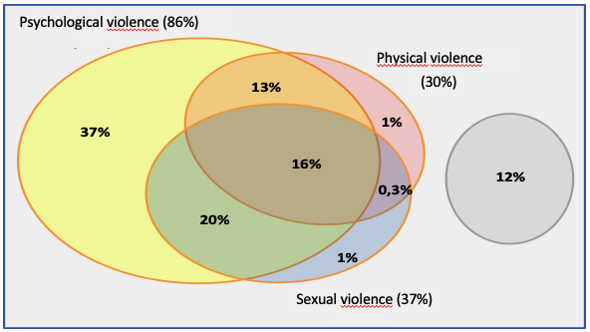
Overlaps in interpersonal violence
Overlapping experiences of violence
Violence rarely occurs alone, but several forms of violence are often experienced
(Ohlert et al., 2020)
Notes:
A 2016 study on competitive sport (Safe Sport Study) analysed whether and how often the various forms of violence overlap.
It can be stated that several forms of violence are usually experienced.
Psychological violence sometimes occurs alone, but usually with other forms of violence
Physical and sexualised violence almost never occurs alone, but is usually accompanied by psychological violence
Reflection
What can be deduced from this for the prevention of violence?
Possible answers:
Sexualised or physical violence cannot be considered in isolation when it comes to prevention, as it does not occur in a vacuum.
A better starting point for sports clubs is to begin with psychological violence (which occurs very frequently) and to be vigilant. Only then can more serious incidents be better avoided.

Slide 18
Violence in competitive and recreational sport
Few differences between recreational and competitive sport:
(Rulofs, Gerlach, et al., 2022)
Notes:
Contrary to what many reports suggest, interpersonal violence is not a problem that only occurs in competitive sport.
Even at the recreational sport level, such as the local level, a large proportion of respondents (68%) experience interpersonal violence:
In particular, participation in competitions (even at a low level) appears to be a risk factor for interpersonal violence
Experiences of violence increase somewhat further as the level rises.
Background information
This data comes from the Safe in Sport study (survey of club athletes).

Slide 19
Place, context and perpetrators
Place and context
Experiences of violence are very often sports clubs made
Before, during or after the regular training
They usually take place within the sports facility (e.g. gymnasium)
Other rooms include changing rooms, showers and treatment rooms
Perpetrators
Perpetrators are most often team colleagues or (co-)coaches
Individual or group offences possible
Gender of the perpetrators: There are both male and female perpetrators; physical and sexualised violence by male perpetrators more frequent
(Rulofs, Gerlach, et al., 2022; Hartill et al., 2023)
Notes:
Location & Context:
Boundary violations can be visible in daily training (e.g. psychological violence as a training method) and often begin gradually
Serious, longer-lasting incidents also frequently occur in other areas, such as changing rooms, car trips, etc.
Perpetrators:
It is both about violence that comes from coaches or assistants as well as violence that athletes inflict on each other (bullying).
Reduce prejudices about perpetrators: There are female and male perpetrators, even in cases of sexualised violence - but there are differences in prevalence.
Background information
This data comes from the Safe in Sport survey (club athletes) and CASES (Europe-wide study on violence in sport).

Slide 20

Characteristics of the persons affected in sport
Age:
Assaults begin mostly in childhood or adolescence
Continuation into adulthood
Gender:
Men (64%) similarly affected as women (77%)
The difference lies in the form of violence: Women experience sexualised violence and neglect much more frequently than men in sport
Sexual orientation:
Particularly vulnerable groups of people in sport are people who are not heterosexual (82%)
Disability:
People with disabilities suffer violence more often than people without disabilities
Sport type:
Interpersonal violence occurs in all sports to a comparable extent
(Rulofs, Gerlach, et al., 2022)
Notes:
There is no specific type of affected person.
However, the current data points to some particular risk factors.
Background information
The data comes from the Safe in Sport survey (club athletes)

Slide 21
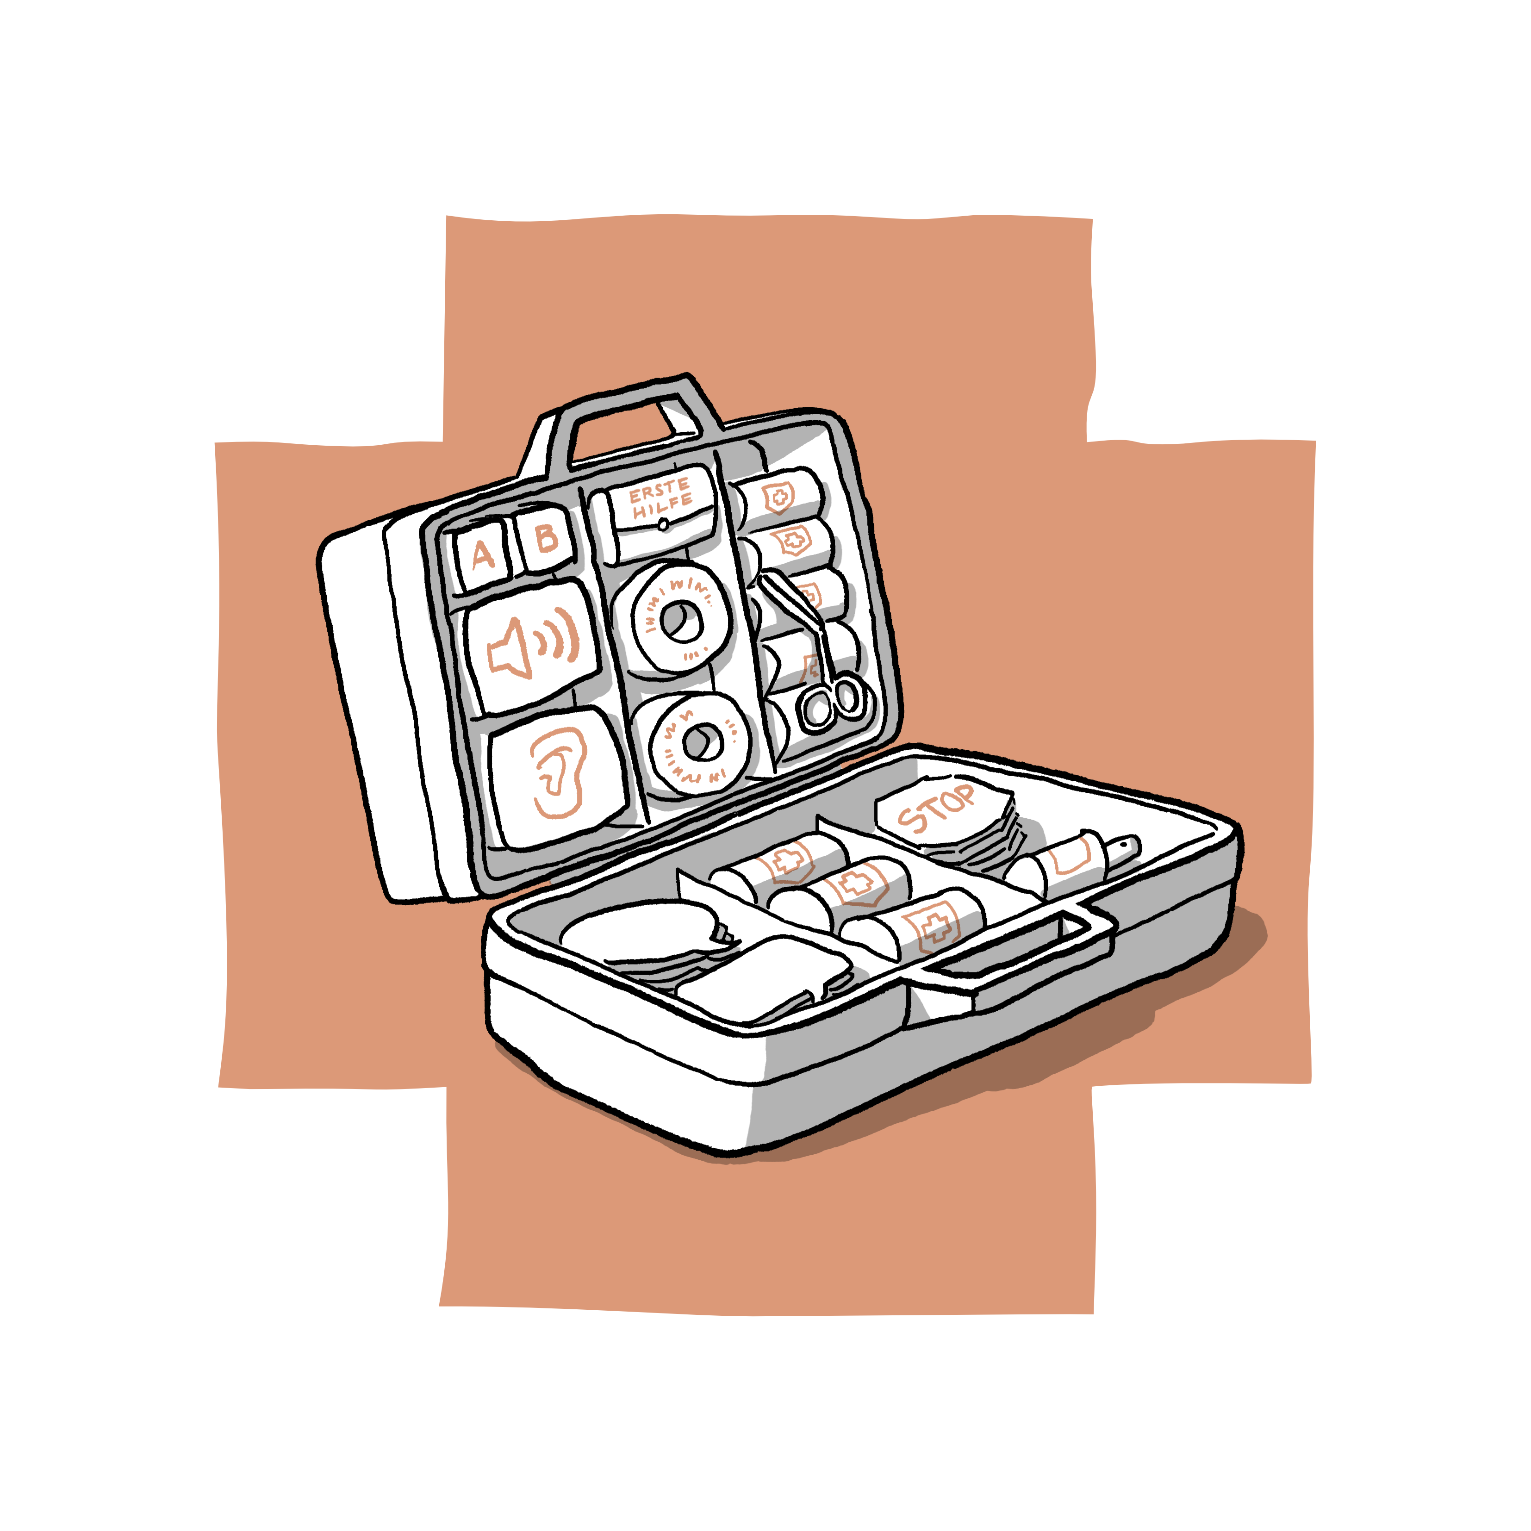
Consequences of interpersonal violence
Effects of interpersonal violence on behaviour in sport:
Less fun and motivation
Disregard of rules, "cheating"
Quitting sport
Consequences for mental health:
Poorer well-being and lower quality of life
Lower self-confidence
Favours the development of psychological problems (e.g. anxiety or eating disorders, depression, addiction)
Physical effects:
Declining performance
Development or aggravation of injuries
(Tuakli-Wosornu et al., 2024)
Notes:
Emphasise that even "minor" boundary violations can have negative consequences.
Persistent interpersonal violence usually increases the stress levels of those affected.
At this point you can provide an opportunity for reflection if there is still some time.

Slide 22

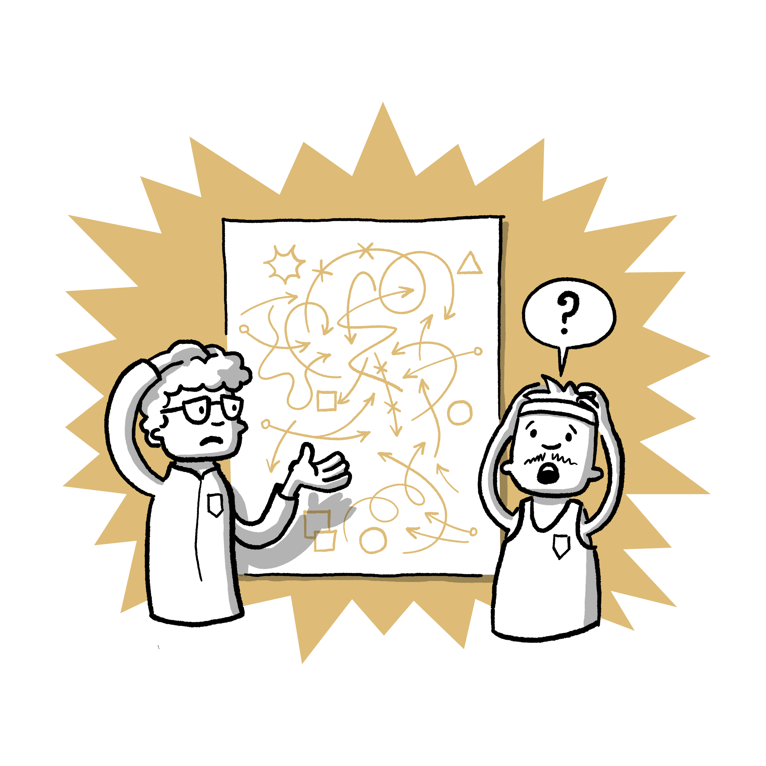
Options for action in the event of boundary violations
Taking action as an adult when you observe boundary violations
Notes:
Participants now know what interpersonal violence in sport is and that there are different types of it
It is important to react and take action if an abusive situation or boundary violation is noticed.
Especially when children or young people are involved and you as an adult have become aware of it.
The following section outlines possible courses of action in the event of suspected boundary violations.

Slide 23
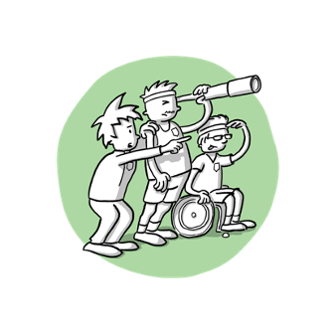
Helpers and bystanders
Bystander:
An uninvolved third person who has observed an assaultive situation or has knowledge of it
95% of respondents to a study in competitive sport stated that they had observed or noticed a situation of interpersonal violence and were therefore bystanders
But:
Bystanders rarely become active:
Only very few people (1-3%) state that violence was ended by the intervention of a third person
Contact persons from clubs are rarely involved (in 8-16% of cases)
Friends, parents or partners are most most frequently informed about incidents (between 11%-37%)
(Rulofs, Ohlert, et al., 2022;
Rulofs, Gerlach et al., 2022)
Notes:
Definition of Bystander:
Someone who has observed a situation/assault, e.g. because they happened to be present
A child has reported a situation/assault
Study from junior competitive sport:
Almost all of the study participants had already observed an assaultive situation or a boundary violation. So all these people were bystanders/observers
However, bystanders rarely help those affected: Around 1-3% of the experiences of violence (depending on the form of violence) were ended by an uninvolved person or the victims were supported by an uninvolved person.
There is therefore great potential for improvement here to the benefit of those affected.
Safe in sport study (club athletes)
Those affected often turn to friends, parents or their partner
These people would therefore be in a position to help or support those affected. This happens in 11-37% of cases (depending on the form of violence).
Those affected are least likely to turn to others in cases of sexualised violence involving physical contact.
Contact persons are rarely contacted directly by victims (8-16% depending on the form of violence of the cases).
Reflection
Why are contact persons historically so rarely involved?
Why are those affected most likely to turn to friends/partners?

Slide 24
Reacting correctly as a bystander
 | Proactive Independent of incidents | Reactive In response to an incident
Positive | Further education and training Be a good role model Consideration of children's rights in sport, e.g. allowing young athletes to have a say | Intervene to put an end to the incident Stand by the person affected Inform parents Involve a contact person
Negative | Trivialisation of violence Promotion of (gender) discrimination Disregard for the opinions and rights of the athletes | Instigating or condoning the behaviour Taking part yourself Not giving any credence Playing down what happened
(McMahon & Banyard, 2012)
Notes:
Presentation of the different ways in which bystanders react in sport:
Differentiation between positive (top line) and negative (bottom line)
As well as between proactive (not in connection with an event) and reactive (in the context of an event).
Optional
Possibility to let the participants give examples themselves.

Slide 25
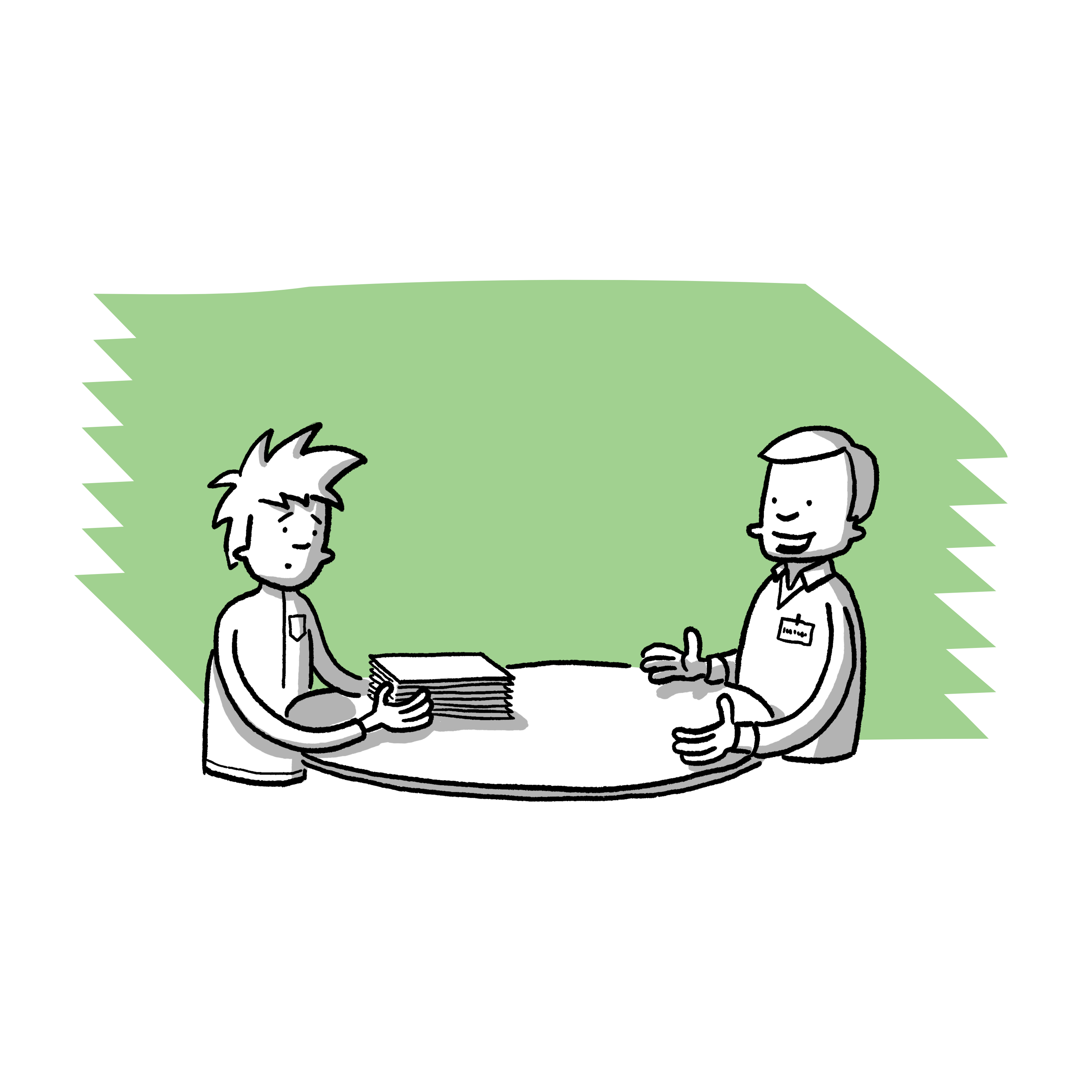
Positive bystander behaviour
During or after the situation
Addressing the person affected
Ask about the observed event
Offer support
Involve contact persons
Contact person of the club, association
Other staff of the organisation (e.g. board, coach)
Specialist counselling centres
During the situation
Remain present
Stay in the room
Offer support afterwards
Distract
Get creative and focus attention on something else
e.g. by asking the person concerned something
Notes:
It is not always easy to be attentive and react in a borderline situation, i.e. to be a "positive bystander". But there are some specific things you can do as a bystander to help:
If something has happened, you can always turn to contact persons at the club, association or specialised counselling centres and ask them for an assessment
You can approach the person concerned about the incident at a suitable time, e.g. by saying that you observed the incident and would like to offer help. This could be offering to talk to someone, accompanying them on their way home or passing on information to a contact person.
In some cases, a boundary violation takes place right in front of you. You can also react in these cases, as long as you do not put yourself in danger:
You can stand by the person concerned and not leave them alone at that moment
Once the incident is over, you can help those affected again.
In some cases, you can creatively provide a distraction by drawing attention to yourself:
E.g. you ask the person concerned about a completely different topic (e.g. when the competition starts)
You deliberately drop something, e.g. a water bottle
Bystanders should avoid direct confrontation with offenders (unless this is unavoidable)
It is important to support those affected and to involve specialised and responsible persons
As a bystander, you do not have to clear up the incident yourself: The contact persons are trained to make an initial assessment of the situation and are familiar with the next steps; for example, they know in which situations it is necessary to involve other agencies.
If there is an acute danger to life or limb, the police should be informed.
Optional
You can insert information on rules of conduct or your club's code of honour here.

Slide 26
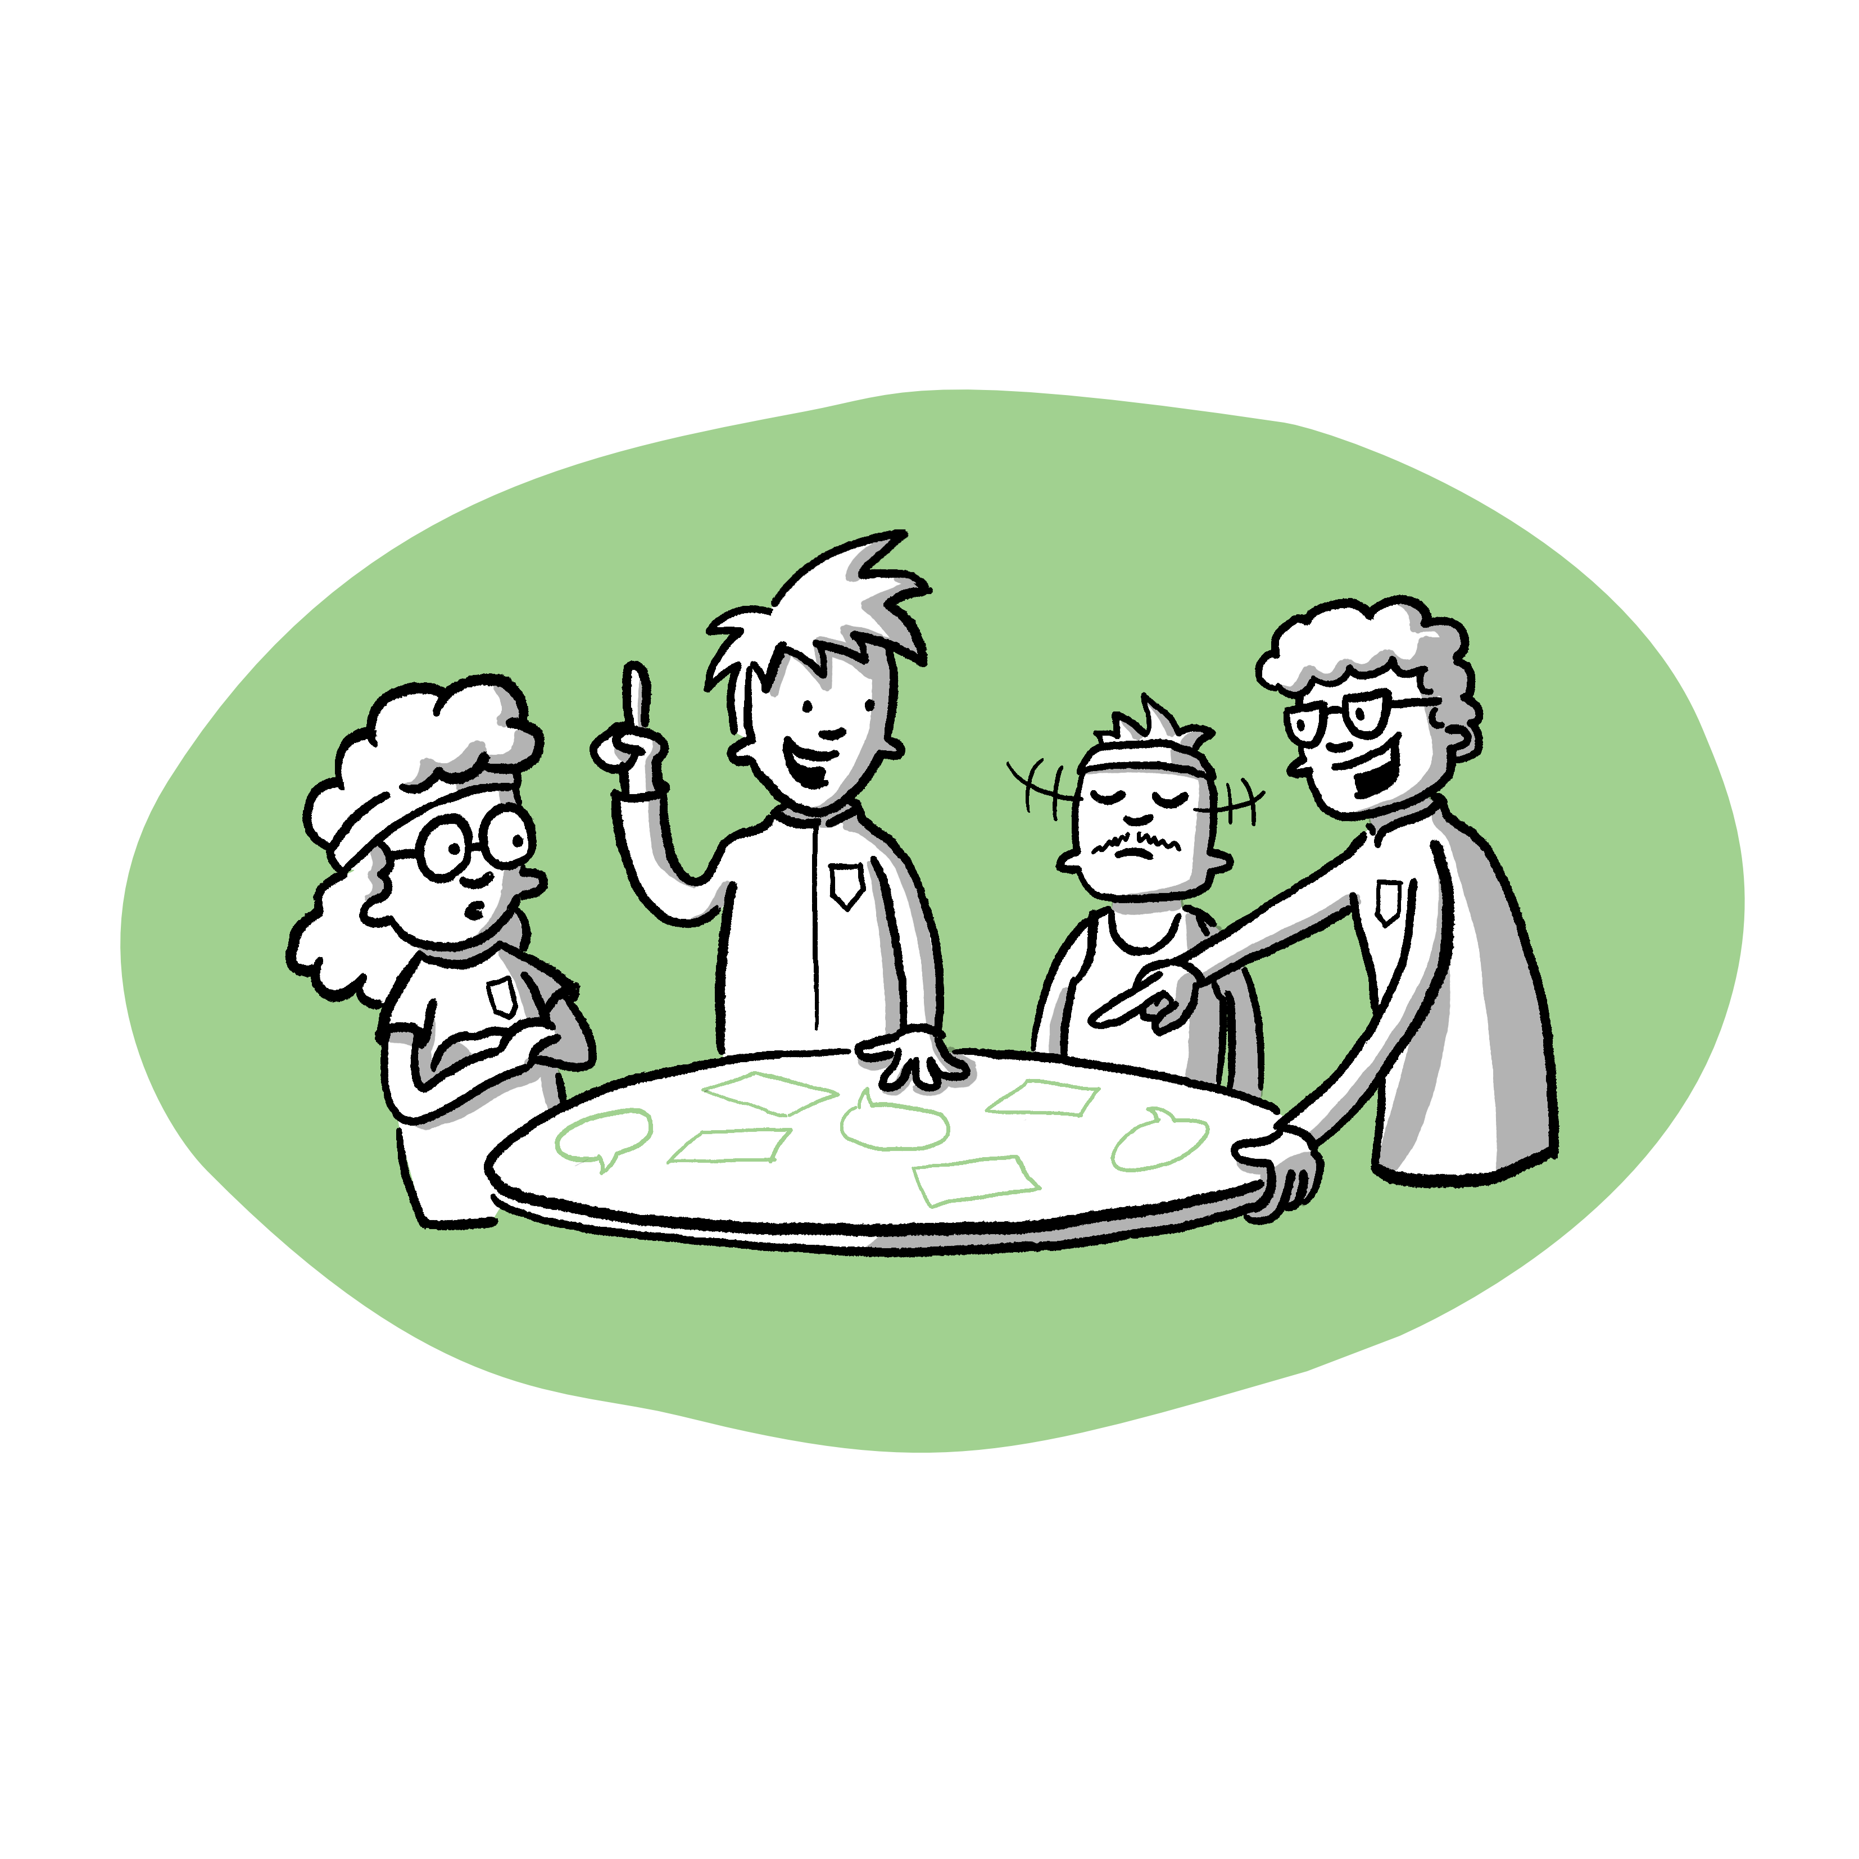
Case studies on "bystander" behaviour
Exercise in (small) groups
Notes:
The group can now try out the positive bystander behaviour using a few case studies
Task
Exercise in (small) groups, split up as required; 3-6 people per group have proved successful.
Discuss scenarios in groups: Discussion and assessment of the initial situation
Consider the exact steps of how you would react as a bystander in this situation
Incorporate previously learnt material and discuss the procedure critically
Agree on a procedure in groups and write it down
Subsequent presentation of the reaction per scenario

Slide 27
Case study 1
Laura and Maximilian are two youth coaches from the local athletics club who regularly drive young athletes to and from training sessions. As a result, they spend a lot of time with the young athletes besides during training sessions and also hear various stories.
One of these stories is exclusively about one of the youngsters, Sebastian. Apparently, Sebastian is systematically excluded and not invited to joint activities organised by his teammates. He is unaware of this because they created a WhatsApp group without him.
During car trips, Laura and Maximilian have also heard that teammates occasionally hide some of Sebastian's clothes and other items in the changing room while he is showering. The teammates also agree not to talk to Sebastian and to occasionally push and tease him during training sessions.
Notes:
Read the case study aloud. You can then move on to group work.
Possible work assignments:
What is your assessment of the situation described?
How would you proceed?
What options would you have to offer the person concerned help?
Reflection
What do you think about this situation?
What would happen if you as a coach did nothing in this situation?
What impact could this situation have on the athletes and/or team if you did nothing?
What would be reasons to (not) intervene as a coach?
What would you do as a coach in this situation?

Slide 28
Resolution of case study 1
These are repeated and serious incidents (bullying) perpetrated against an individual by the sports group
The club's contact person should be consulted for advice
The athlete concerned, Sebastian, can be contacted:
  How is he doing?
  What does he need or want?
  How can he be helped?
In the second step, the bullying by the sports group should be addressed:
  Name the misbehaviour
  Announce consequences clearly
  Ask for reasons for the behaviour
  Involve the group in how the situation can improve
Notes:
At this point, record the suggestions and objections from the small groups, e.g. on moderation cards.

Slide 29
Case study 2
Lisa is a 14-year-old volleyball player. She injured her back just before an important match.
As the coach of the younger volleyball players, you overhear a conversation between player Lisa and her coach Anna. Anna asks Lisa to continue training despite the injury and to play this weekend. Coach Anna tells Lisa that the team has no chance of winning without her. The game is decisive for promotion to a higher league. She persuades Lisa to play along, despite the pain and against the doctor's advice that she should rest.
Notes:
Read the case study aloud. You can then move on to group work.
Possible work assignments:
What is your assessment of the situation described?
How would you proceed?
What options would you have to offer the person concerned help?
Reflection
What do you think about this situation?
What would happen if you as a coach did nothing in this situation?
What impact could this situation have on the athletes and/or team if you did nothing?
What would be reasons to (not) intervene as a coach?
What would you do as a coach in this situation?

Slide 30
Resolution of case study 2
In this situation, you should react immediately, as this is a clear violation of boundaries.
Possibilities:
Talk to coach Anna directly: Players may not participate in games against medical advice
If direct communication is not possible: Involve the club's contact person
Address player Lisa:
  Address the content of the overheard conversation and ask them about their well-being
  Confirm that their coach is not allowed to use them with the injury
  You could also advise her to get in touch with her parents or the contact person if this happens again
Involve parents: Ensure that they are informed about the situation and know the organisation's position (no sport against medical advice)
Notes:
At this point, record the suggestions and objections from the small groups, e.g. on moderation cards.

Slide 31
Case study 3
After the training session of a mixed training group (football, age approx. 12 years), you observe the two players Tom and Achim walking towards the girls' changing room and shower.
The next day, one of the girls comes to you and says that Tom and Achim secretly took photos of the girls in the shower. The girls have heard that the pictures have been sent around and have already ended up in the boys' WhatsApp group. The girls are frightened and fear that the pictures will continue to do the rounds.
Notes:
Read the case study aloud. You can then move on to group work.
Possible work assignments:
What is your assessment of the situation described?
How would you proceed?
What options would you have to offer the person concerned help?
Reflection
What do you think about this situation?
What would happen if you as a coach did nothing in this situation?
What impact could this situation have on the athletes and/or team if you did nothing?
What would be reasons to (not) intervene as a coach?
What would you do as a coach in this situation?

Slide 32
Resolution of case study 3
This is a serious incident that requires immediate action.
Inform the contact person immediately, who will consult other specialist counselling centres if necessary
A discussion with the parents, the persons concerned and the two boys led by the contact person is necessary
Further steps will be taken by those responsible at the club and must be communicated with those affected and the parents
Notes:
See case study 1, and:
This shows that immediate action must be taken by calling in experts in serious cases.
In serious cases, other specialised agencies or the police may also be called in immediately.

Slide 33
Introduction of the contact person
Name, function/tasks in the organisation, background as contact person, responsibilities.
Availability (e-mail, telephone, web form, in person, etc.)
Notes:
Please complete this form in consultation with the club or contact person.
The contact person will be happy to introduce themselves personally.
Further information on protection processes in the organisation can also be presented here (protection concepts, prevention measures, etc.).

Slide 34
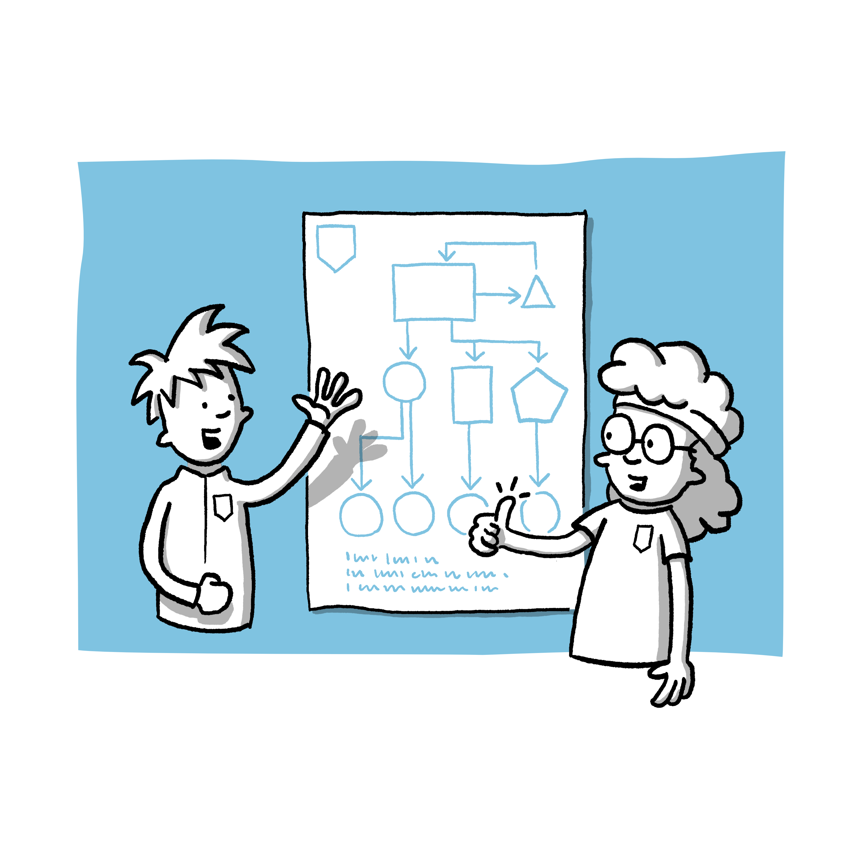
Take-Home Message
Notes:
Joint reflection on the workshop based on questions in a flashlight round, e.g:
What are you taking away from the workshop?
What was new?
What will you change in the future?
The following points can be added, for example, if required:
Interpersonal violence is quite common and the forms overlap
The focus on children's rights is helpful in clearly defining boundaries in sport
Every form of violence is potentially harmful to those affected
If you have a suspicion, you should definitely take action, e.g. by asking the contact person at the club for advice.

Slide 35

Possible offers of help
Contact persons in the organisation
Name local contact points/cooperation partners
Name contact points of the association/state sports association or similar
SafeSport point of contact:
  https://www.ansprechstelle-safe-sport.de
  Phone: +49 (0)800 11 222 00
Nummer gegen Kummer:
  https://www.nummergegenkummer.de
  Phone: 116 111
Help portal for sexual abuse:
  https://www.hilfe-portal-missbrauch.de/en/home
  Phone: +49 (0)8002255530
Notes:
Zum Abschluss sollen die Teilnehmenden die Gelegenheit haben, sich über weiterführende Hilfsangebote zu informieren.
Bitte passen Sie diese Folie an den jeweiligen Sportverein und die Region an.
Beachten Sie, dass die Ansprechstellen und deren Erreichbarkeit sich zwischenzeitlich ändern können, prüfen Sie daher die angegebenen Links und Telefonnummern.

Slide 36
Thank you very much for your attention!
Are there any questions?
Notes:
Geben Sie den Teilnehmenden nochmals die Möglichkeit, Fragen zu stellen.
Anschließend können Sie den Workshop beenden, indem Sie sich für die Teilnahme bedanken und sich verabschieden.
Bitte bleiben Sie nach Abschluss des Workshops einige Zeit im Raum, sodass die Teilnehmenden noch Gelegenheit für individuelle Rückfragen haben

Slide 37
Literature
Hartill, M., Rulofs, B., Allroggen, M., Demarbaix, S., Diketmüller, R., Lang, M., Martin, M., Nanu, I., Sage, D., Stativa, E., Kampen, J., & Vertommen, T. (2023). Prevalence of interpersonal violence against children in sport in six European countries. Child Abuse & Neglect, 146, 106513. https://doi.org/10.1016/j.chiabu.2023.106513
MAKISTA e.V. (o.J.) Bildung für Kinderrechte und Demokratie. Abgerufen am 21.01.2025 von https://www.makista.de/
McMahon, S., & Banyard, V. L. (2012). When can I help? A conceptual framework for the prevention of sexual violence through bystander intervention. Trauma, Violence, & Abuse, 13(1), 3–14. https://doi.org/10.1177/1524838011426015
Ohlert, J., Vertommen, T., Rulofs, B., Rau, T., & Allroggen, M. (2020). Elite athletes’ experiences of interpersonal violence in organized sport in Germany, the Netherlands, and Belgium. European Journal of Sport Science, 21(4), 604–613. https://doi.org/10.1080/17461391.2020.1781266
Rulofs, B., Allroggen, M., Ohlert, J., Gramm, C., Rau, T., Wagner, I., Hartmann-Tews, I., Feiler, S., & Breuer, C. (2016). »Safe Sport« Schutz von Kindern und Jugendlichen im organisierten Sport in Deutschland. Deutsche Sporthochschule Köln & Universitätsklinikum Ulm. https://www.uniklinik-ulm.de/fileadmin/default/Kliniken/Kinder-Jugendpsychiatrie/Dokumente/Safe_Sport_Abschlussbericht.pdf
Rulofs, B., Gerlach, M., Kriscanowits, A., Mayer, S., Rau, T., Wahnschaffe-Waldhoff, K., Wulf, O., & Allroggen, M. (2022). SicherImSport: Sexualisierte Grenzverletzungen, Belästigung und Gewalt im organisierten Sport – Häufigkeiten und Formen sowie der Status Quo der Prävention und Intervention. Deutsche Sporthochschule Köln & Universitätsklinikum Ulm. https://www.lsb.nrw/fileadmin/global/media/Downloadcenter/Sexualisierte_Gewalt/Bericht_zum_Forschungsprojekt_SicherImSport.pdf
Rulofs, B., Ohlert, J., Hartmann-Tews, I. Axmann, G., Brennecke, D., Hoffmann, B., Schäfer-Pels, A. & Allroggen, M. (2022). Trainer*innen als zentrale Akteur*innen in der Prävention sexualisierter Gewalt: Umgang mit Nähe und Distanz im Verbundsystem Nachwuchsleistungssport (TraiNah).Deutsche Sporthochschule Köln. https://www.bisp.de/SharedDocs/Downloads/Projektlisten/Projekte_2022/TrainahPraeventionSexualisierterGewalt.pdf?__blob=publicationFile
Sportjugend Hessen: Kinderrechte im Sport. (o.J.). Abgerufen am 21.01.2025 von https://www.sportjugend-hessen.de/themen/kindeswohl/kinderrechte-im-sport/
Tuakli-Wosornu, Y. A., Burrows, K., Fasting, K., Hartill, M., Hodge, K., Kaufman, K., Kavanagh, E., Kirby, S. L., MacLeod, J. G., Mountjoy, M., Parent, S., Tak, M., Vertommen, T., & Rhind, D. J. A. (2024). IOC consensus statement: Interpersonal violence and safeguarding in sport. British Journal of Sports Medicine, 58(22), 1322–1344. https://doi.org/10.1136/bjsports-2024-108766
UBSKM. (2021, Oktober 14). Sexueller Missbrauch – Was ist strafbar bei sexueller Gewalt gegen Kinder und Jugendliche? [Video].YouTube. https://www.youtube.com/watch?v=dCrp6w2WdeY&t=10sund
World Health Organization (Ed.). (2002). World report on violence and health. World Health Organization.

Slide 38
Citation
If you would like to cite this workshop, please use the following format:
Greither, T., Schmitz, H., Sulprizio, M., Allroggen, M., & Ohlert, J. (2025). Safe Space sports club - raising awareness on the topic of child protection [workshop concept]. German Sport University Cologne and University Hospital Ulm.

Slide 39
Imprint
Publishers
German Sport University Cologne
Psychological Institute
Dept. of Health & Social Psychology
Am Sportpark Müngersdorf 6
50933 Cologne, Germany
www.dshs-koeln.de/psychologisches-institut/
University Hospital Ulm
Clinic for Child and Adolescent Psychiatry, Psychosomatics, and Psychotherapy
Research Group Violence, Developmental Psychopathology, and Forensics
Steinhövelstraße 5
89075 Ulm, Germany
https://www.uniklinik-ulm.de/kinder-und-jugendpsychiatrie-psychosomatik-und-psychotherapie.html
Available from
"SafeClubs" project - transfer concepts for the prevention and intervention of sexual violence in sports clubs
Collaboration management: Dr. Jeannine Ohlert (German Sport University Cologne)
Sub-project management: Dr. Jeannine Ohlert, Univ. Prof. Dr. Bettina Rulofs (both German Sport University Cologne), Prof. Dr. med. Marc Allroggen,
Dr. Alina Schäfer-Pels (both University Hospital Ulm)
Collaboration coordination: Marion Sulprizio (German Sport University Cologne)
Collaboration: Helena Schmitz, Annika Söllinger, Janna Kerkow, Sina Kiekbusch, Paula Edler (all German Sport University Cologne), Teresa Greither
(University Hospital Ulm)
https://safe-clubs.de

Slide 40
Imprint
Authors
Teresa Greither^{1,2}, Helena Schmitz³, Marion Sulprizio³, Marc Allroggen^{1,2} & Jeannine Ohlert^{3,4}
¹ University Hospital Ulm, Clinic for Child and Adolescent Psychiatry, Psychosomatics, and Psychotherapy
² German Center for Mental Health (DZPG), partner site Ulm
³ Psychological Institute, German Sport University Cologne
⁴ German Research Centre of Elite Sport (momentum), Cologne
With contributions from Janna Kerkow, Sina Kiekbusch, Vivian Gast (all German Sport University Cologne)
Image credit Marcel Jansen, Instagram: @mrcl_cartoons
Funding Acknowledgment The project underlying this report was funded by the Federal Ministry of Education and Research under the grant number 01SR2106A. The responsibility for the content of this publication lies with the authors.
Publication Date: January 2025 – Digital Version
Copyright © German Sport University Cologne and University Hospital Ulm, 2025
All Rights Reserved Without the express permission of the University Hospital Ulm and the German Sport University Cologne, it is not permitted to reproduce the content of this presentation or parts thereof by photographic, printing, or digital means for commercial purposes.
Texts, tables, and graphics may gladly be used for voluntary work, including in sports federations and clubs.

